Slide 1
Swept AABB collision detection

Slide 2
Objectives
Understand swept AABB algorithm to test collision between a moving object and a static object

Slide 3
Naïve approach
Wall
Last frame
Current frame
Check intersection at current frame sometimes won’t work if, at current frame, object does not intersect with target object. In fact, they collided in the PAST

Slide 4
One dimension thinking
M: moving object
S: static object
d
M
S
V : object velocity
d = V * dt ( distance M actually moves in a frame )
dt = t_{this frame} – t_{last frame}
IMPORTANT: d is negative if moving right to left

Slide 5
One dimension thinking
d
M
S
M
d_{entry}
d_{exit}
IMPORTANT: BOTH d_{endy} and d_{exit} can be negative

Slide 6
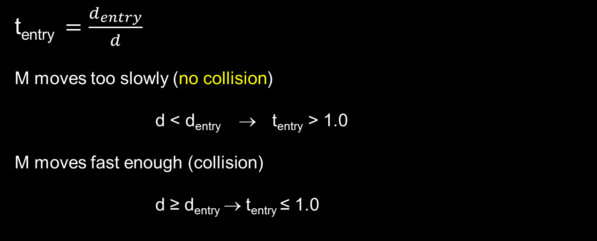

One dimension thinking
d
M
S
M
d_{entry}
d_{exit}

Slide 7
One dimension thinking
d
S
M
d_{exit}
d_{entry}
M moves in opposite direction (trivial no collision)
d_{entry} < 0 AND d > 0 → t_{entry} < 0
Collision : 0 < t_{entry} ≤ 1

Slide 8
Applying for 2 dimensions
dx_{entry}, dx_{exit}, tx_{entry}, tx_{exit},
dy_{entry}, dy_{exit} , ty_{entry}, ty_{exit},
Collide = collide on both axis
t_{entry} = Collide “time” = max(tx_{entry}, ty_{entry})
x += v*dt
x’ = x + v*dt*t
t = dt’ / dt

Slide 9
Applying for 2 dimensions
Collide = collide on both axis
t_{entry} = Collide “time” = max(tx_{entry}, ty_{entry})
t_{exit} = Exit “time” = min(tx_{exit}, ty_{exit})
t_{entry} < t_{exit}
tx_{entry}
tx_{exit}
ty_{entry}
ty_{exit}

Slide 10
Applying for 2 dimensions
max(tx_{entry}, ty_{entry})
min(tx_{exit}, ty_{exit})
tx_{entry}
ty_{entry}
tx_{exit}
ty_{exit}
ty_{entry}
tx_{entry}
ty_{exit}
tx_{exit}

Slide 11
Collision direction
if (txEntry > tyEntry) {
if (dxEntry < 0.0f) {
normalx = 1.0f;
normaly = 0.0f;
} else {
normalx = -1.0f;
normaly = 0.0f;
}
} else {
if (dyEntry < 0.0f) {
normalx = 0.0f;
normaly = 1.0f;
} else {
normalx = 0.0f;
normaly = -1.0f;
}
}

Slide 12
Swept AABB will not work if M and S are already overlapped

Slide 13
Broad phase test first!

Slide 14
Collision between 2 moving objects?
Well, moving is relative!
Select one object and make it static
Change moving object velocity
M’_{V} = M_{V} – S_{V}
Changing velocity of one object is only for the sake of collision detection. DO NOT change the actual velocity of the object. ☺

Slide 15
Gravity & platform

Slide 16
Filtering collisions
without 0.4f pushback d_{entry} will be 0 next frame

Slide 17
Camera
x_{cam}
x
y_{cam}
x'
y
y'

